Slide 1
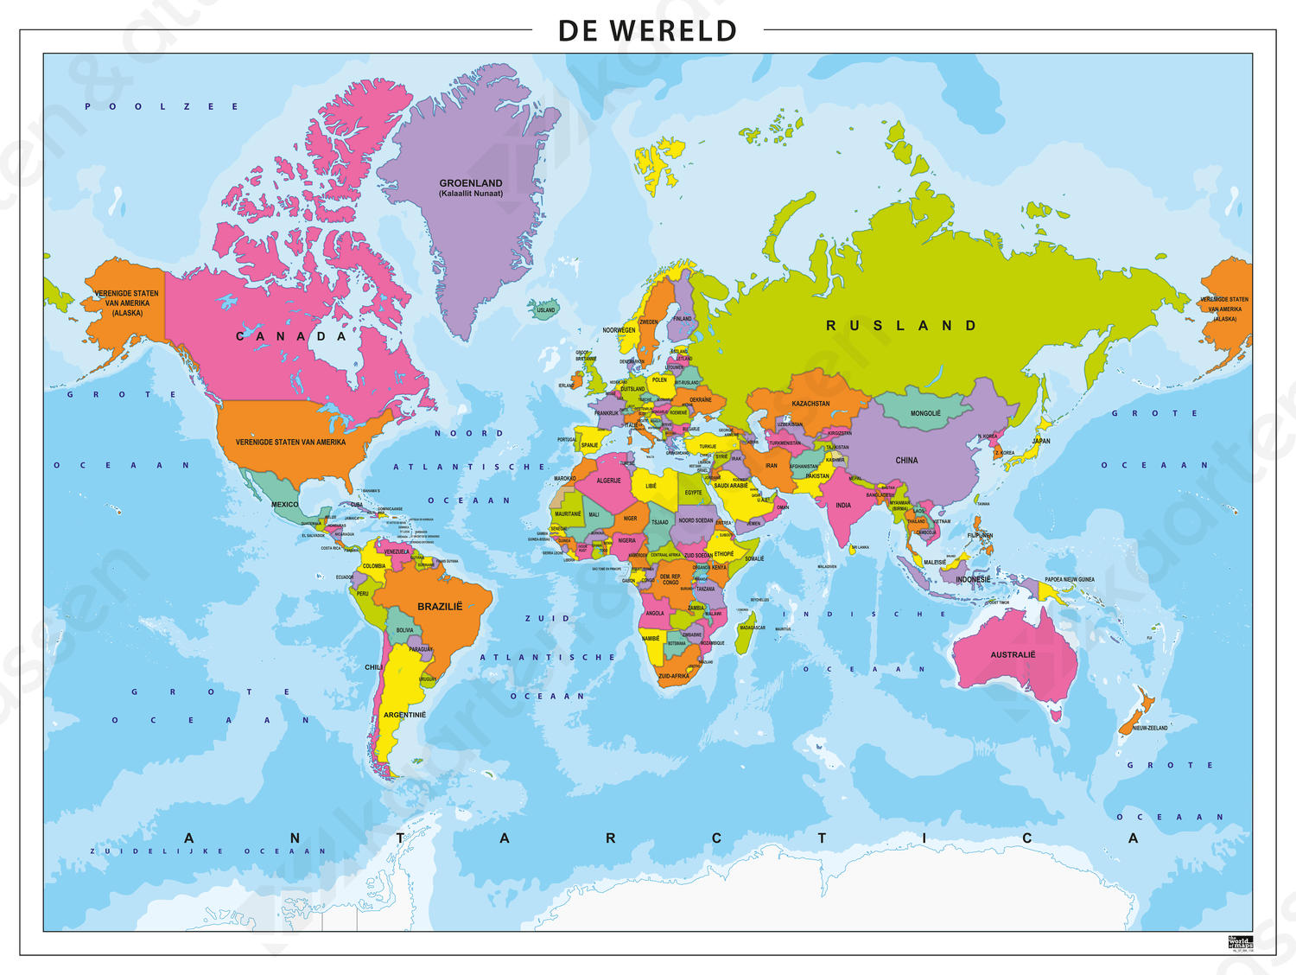

Slide 2
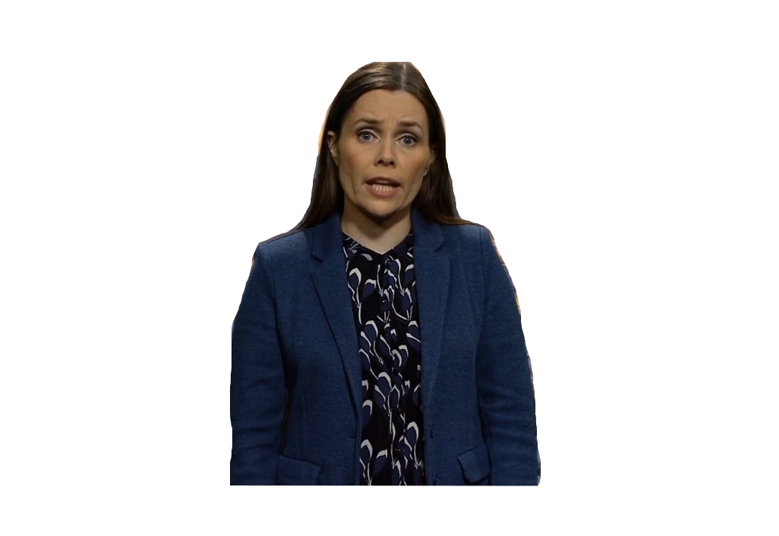

Slide 3


Slide 4


Slide 5


Slide 6


Slide 7


Slide 8
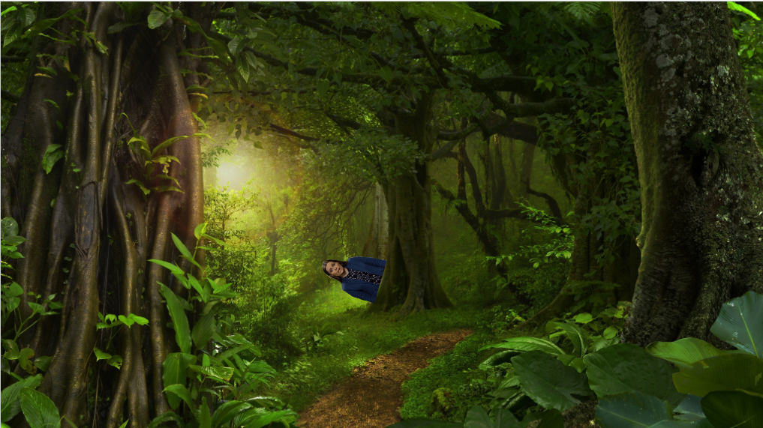
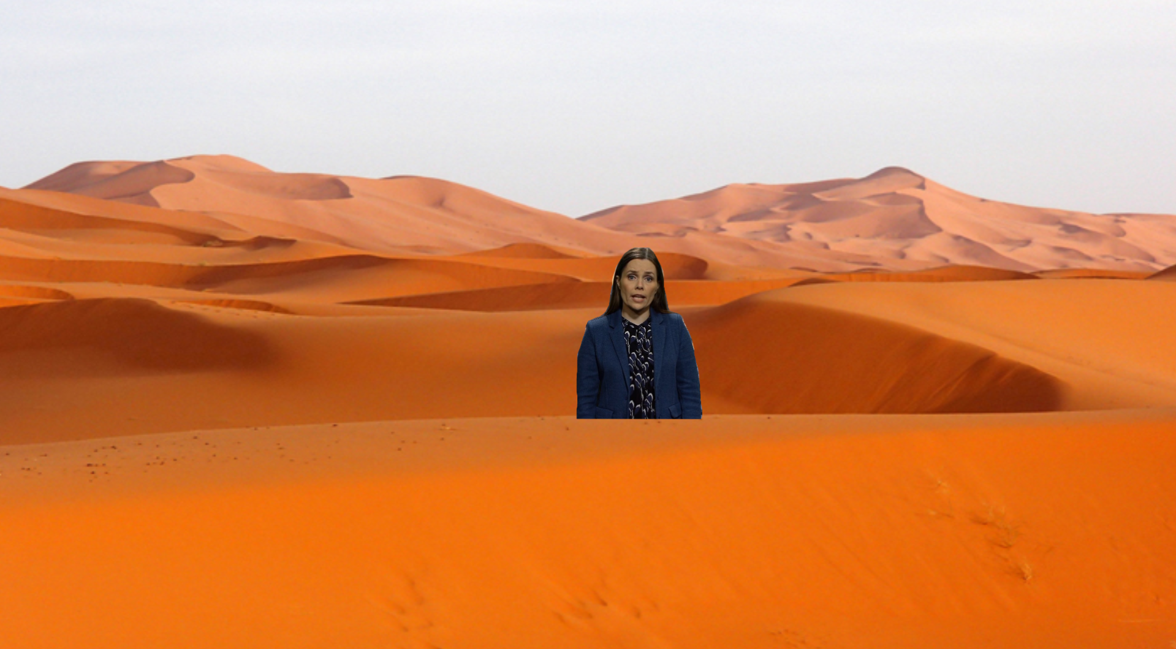
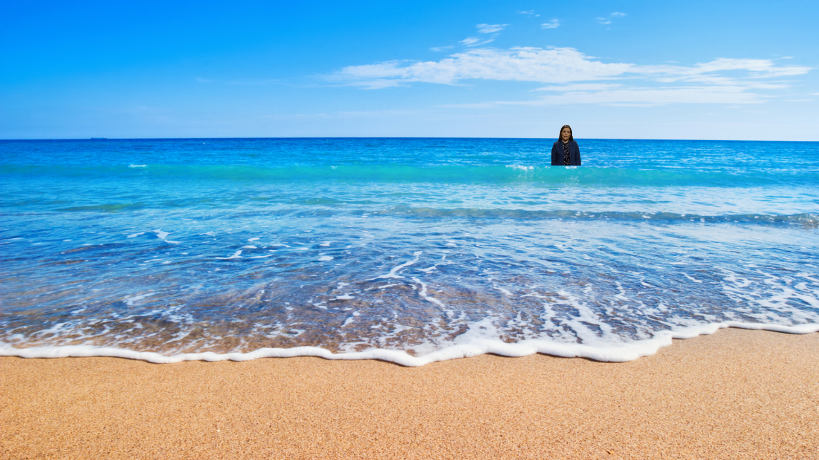



Welke is de juiste foto?

Slide 9
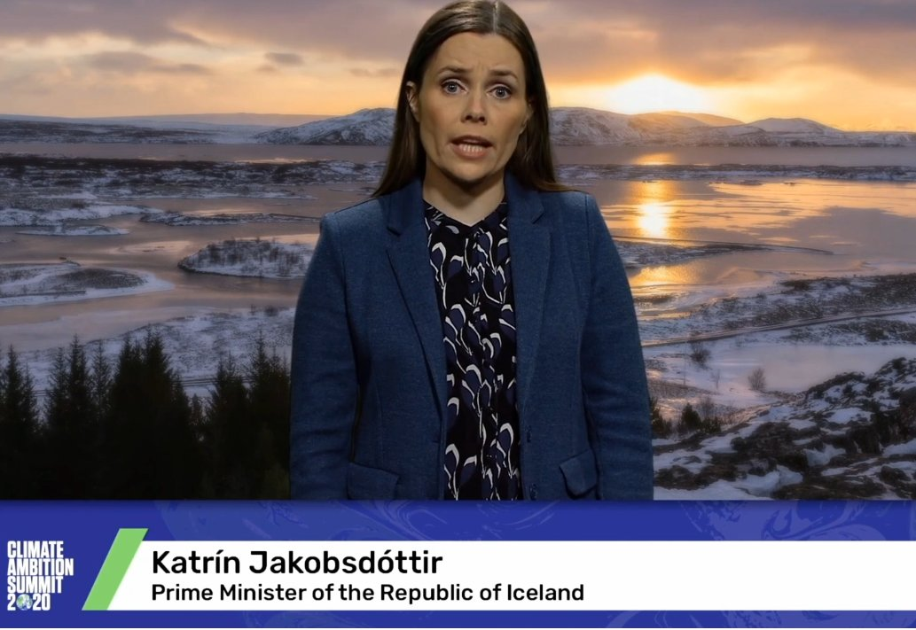


Slide 10


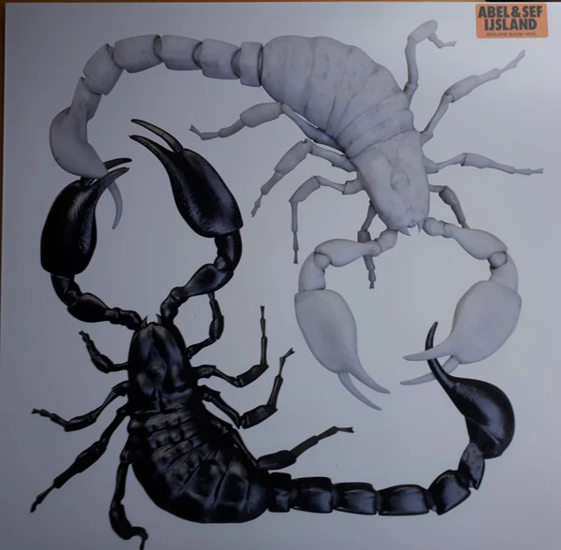

Uitleg Hints
Prada stelen

Slide 11

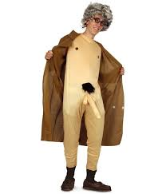

Uitleg hints

Slide 12
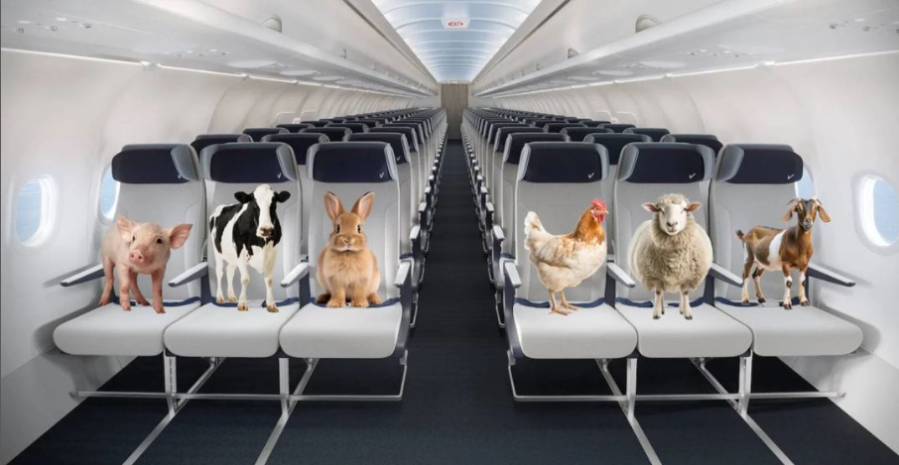

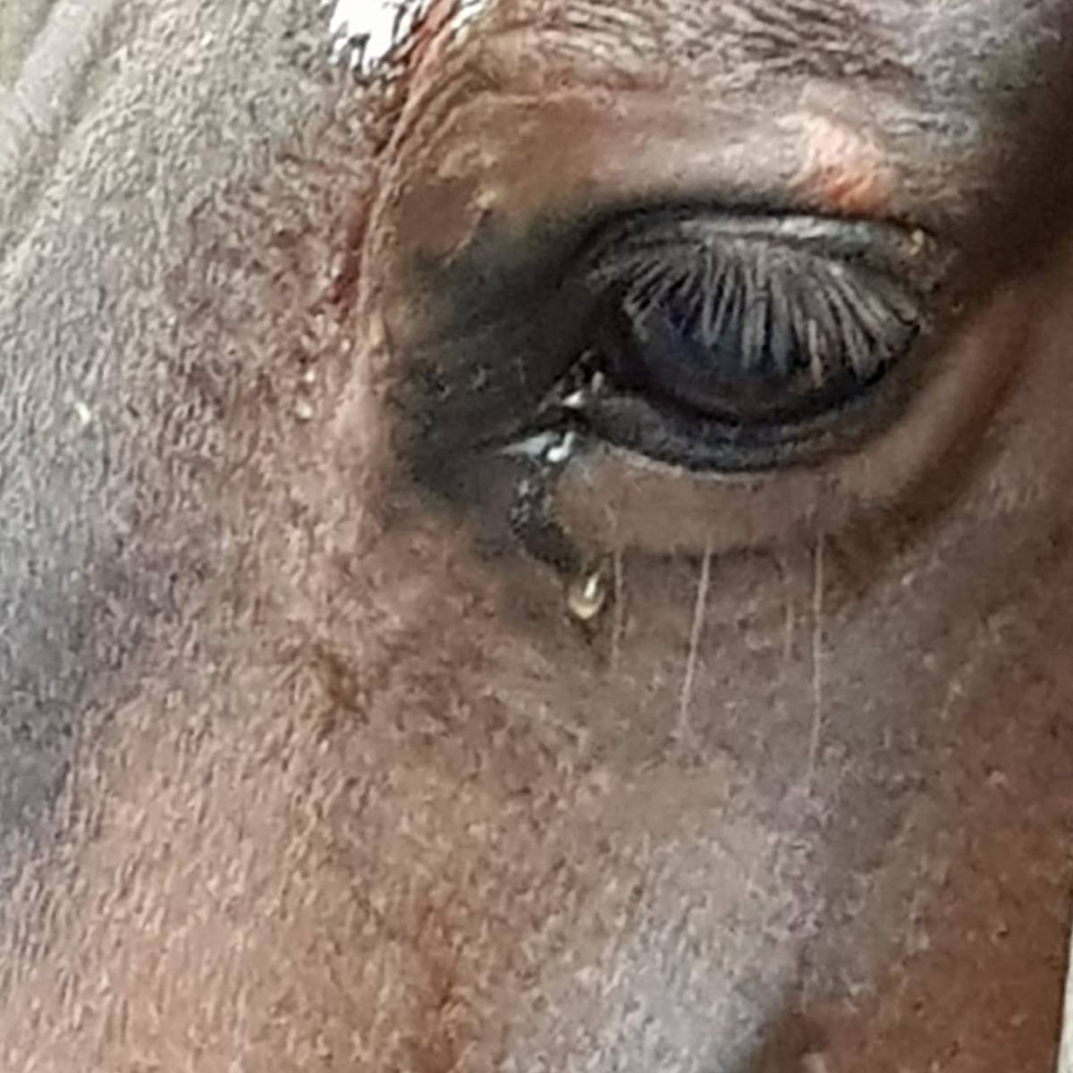

Uitleg hints

Slide 13
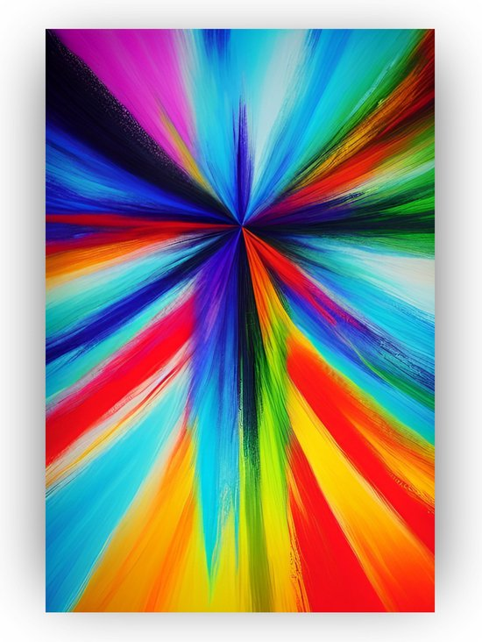
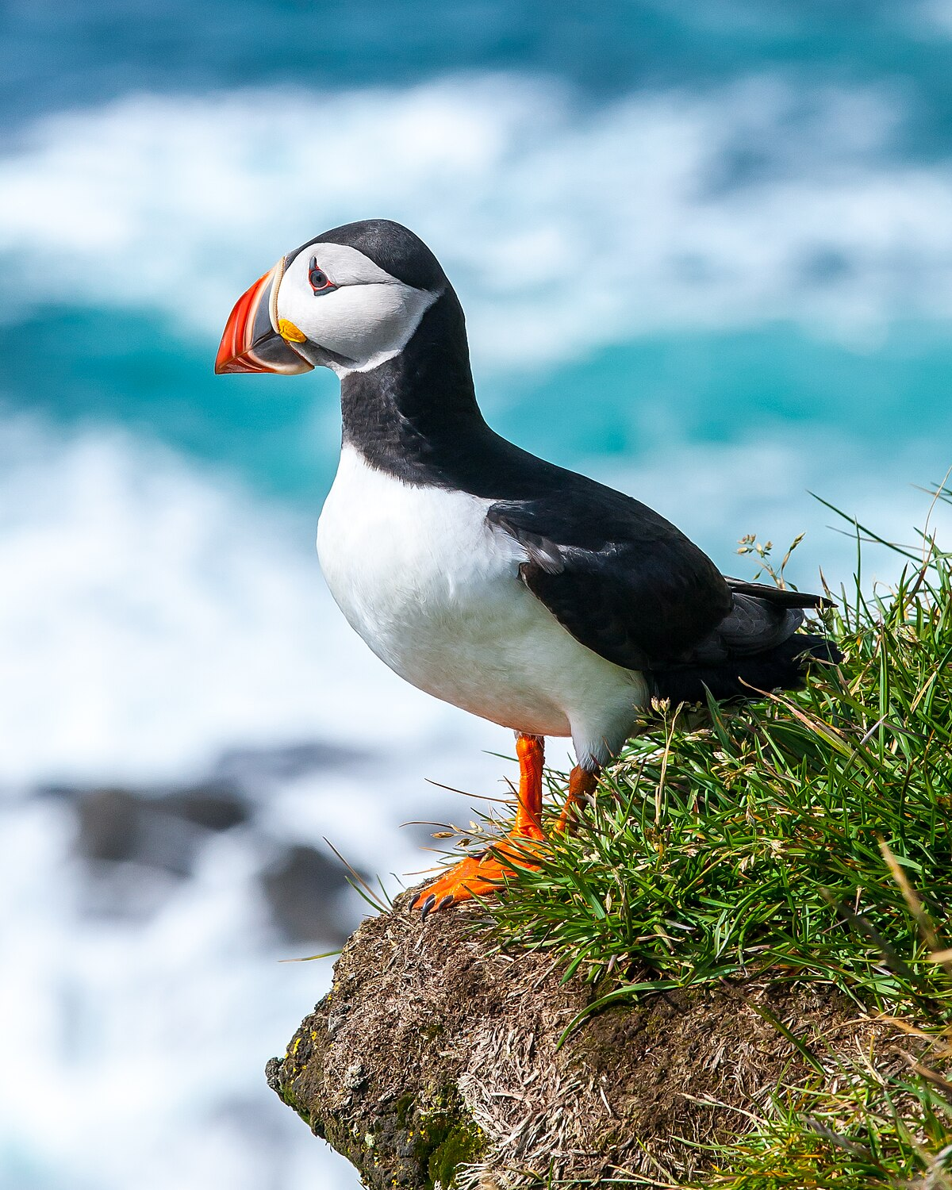
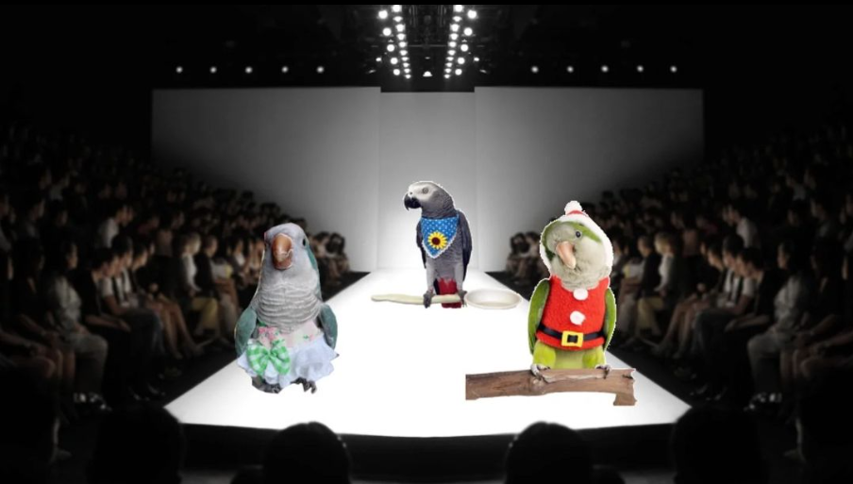
Uitleg Hints

Slide 14
Details
When? Saturday April 12th (morning) until Sunday April 20th.
Beware: when you participate you miss the retake week of the 2nd period.
Price: 700 euros max.
  Included is transportation, 3 meals a day, accomodation, visits to chemical companies and universities and a cultural activity!

Slide 15
What do we expect?
24 enthusiastic participants
Interest in chemistry and culture of the Czech Republic
Active participation before, during and after the trip, including an assignment before and after the trip
Neat clothes during visits

Slide 16
Sign up now!
Deadline is December 10th 17:00
Poster to sign up will be in the Protonkamer after today
Selection procedure: drawing of lots
  If it is your first time, you get 2 lots. Second time or more, you get 1 lot.

Slide 17


Questions?
Ask them now (or later personal/email)
E-mail: info@protoninternational.nl
Website: www.protoninternational.nl
Instagram: @protonstagram_international

