Slide 1
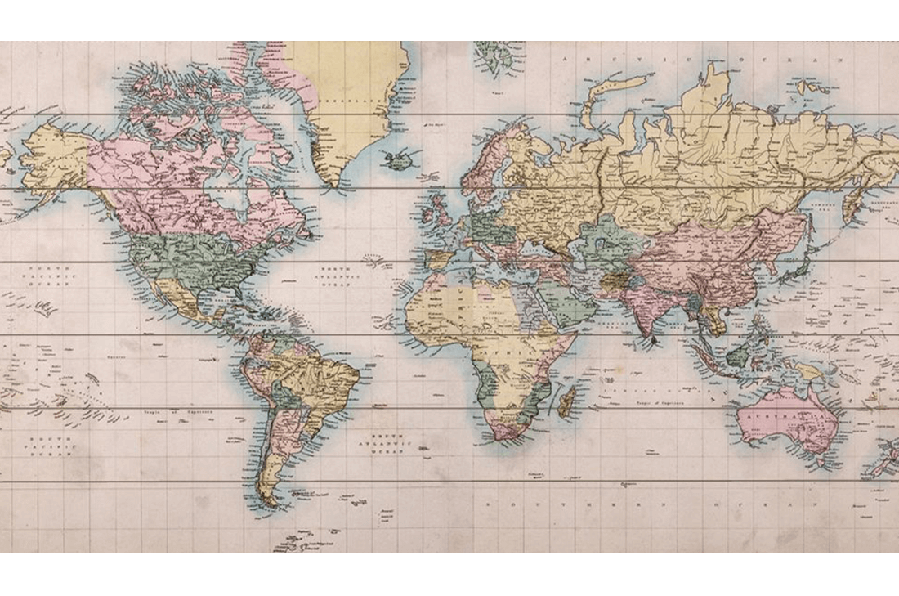
Proton International: Information Gathering 1
November 16th 2023

Slide 2
The committee
Minka Chair
Iris Secretary
Ruben Treasurer
Stefan Accommodation
Ruerd Transport
Marije Promotion
Tessa Acquisition

Slide 3
Destination reveal
Quick poll...

Slide 4
A
B
C
D

Slide 5
A
B
D
C

Slide 6
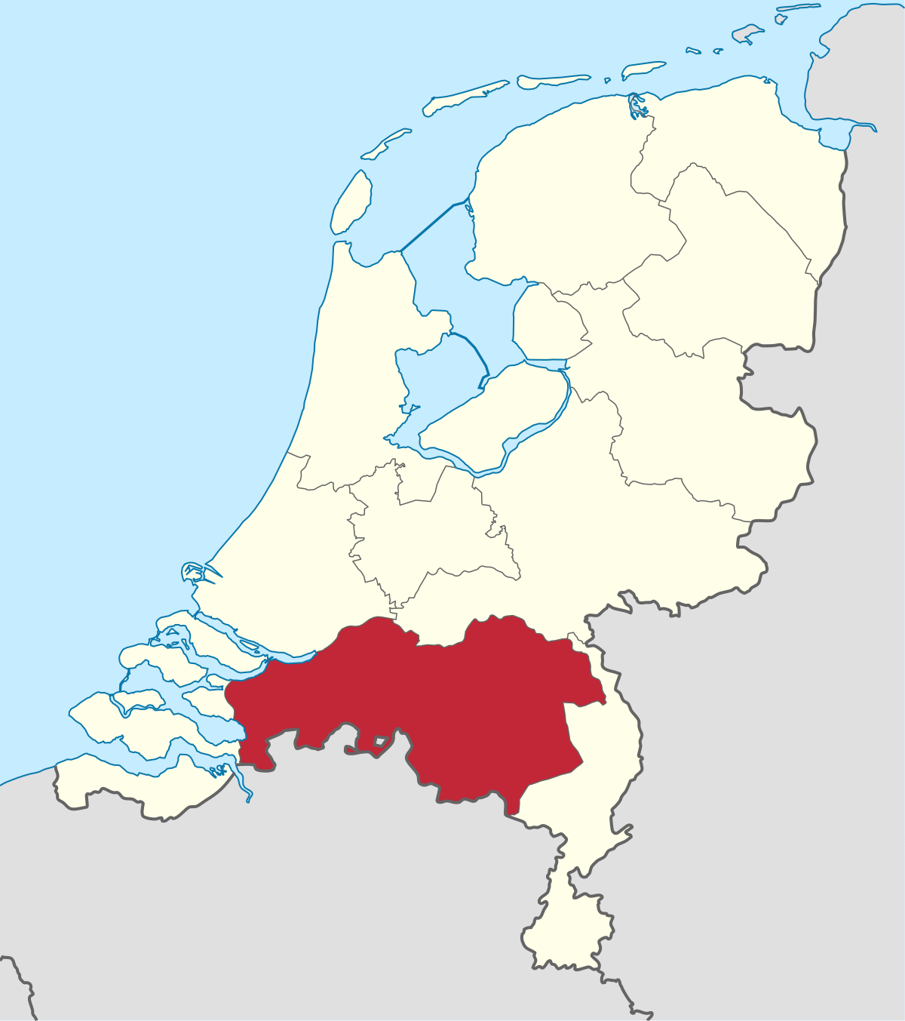
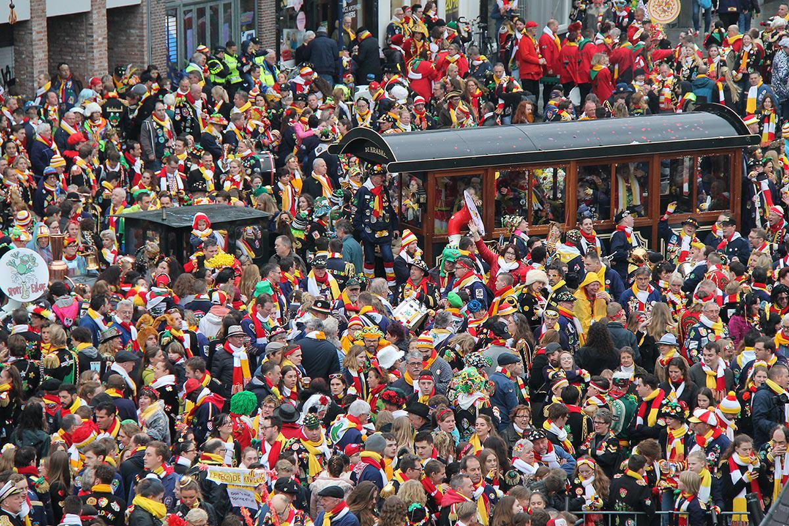

Hints explained

Slide 7

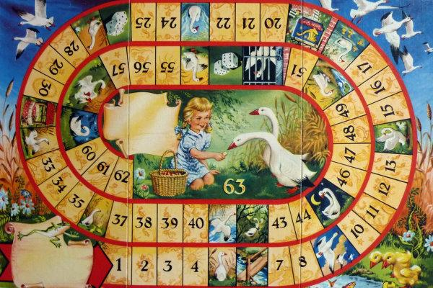
Hints explained

Slide 8
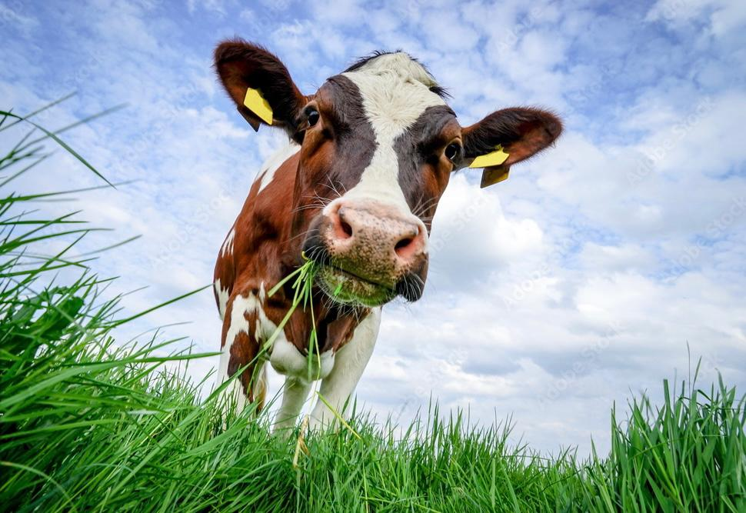

Hints explained

Slide 9

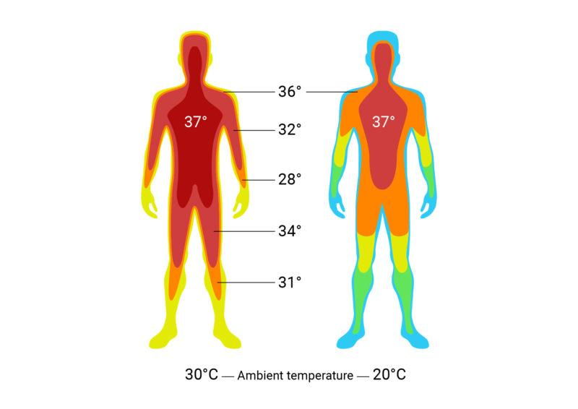

Hints explained
37th board

Slide 10
PI 2023 goes to …..
Singapore

Slide 11
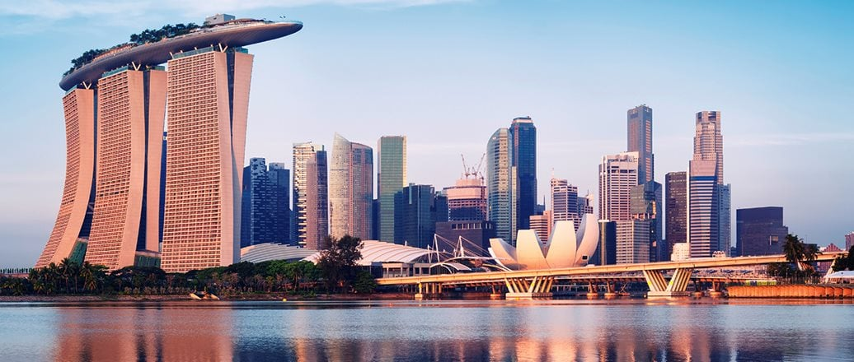
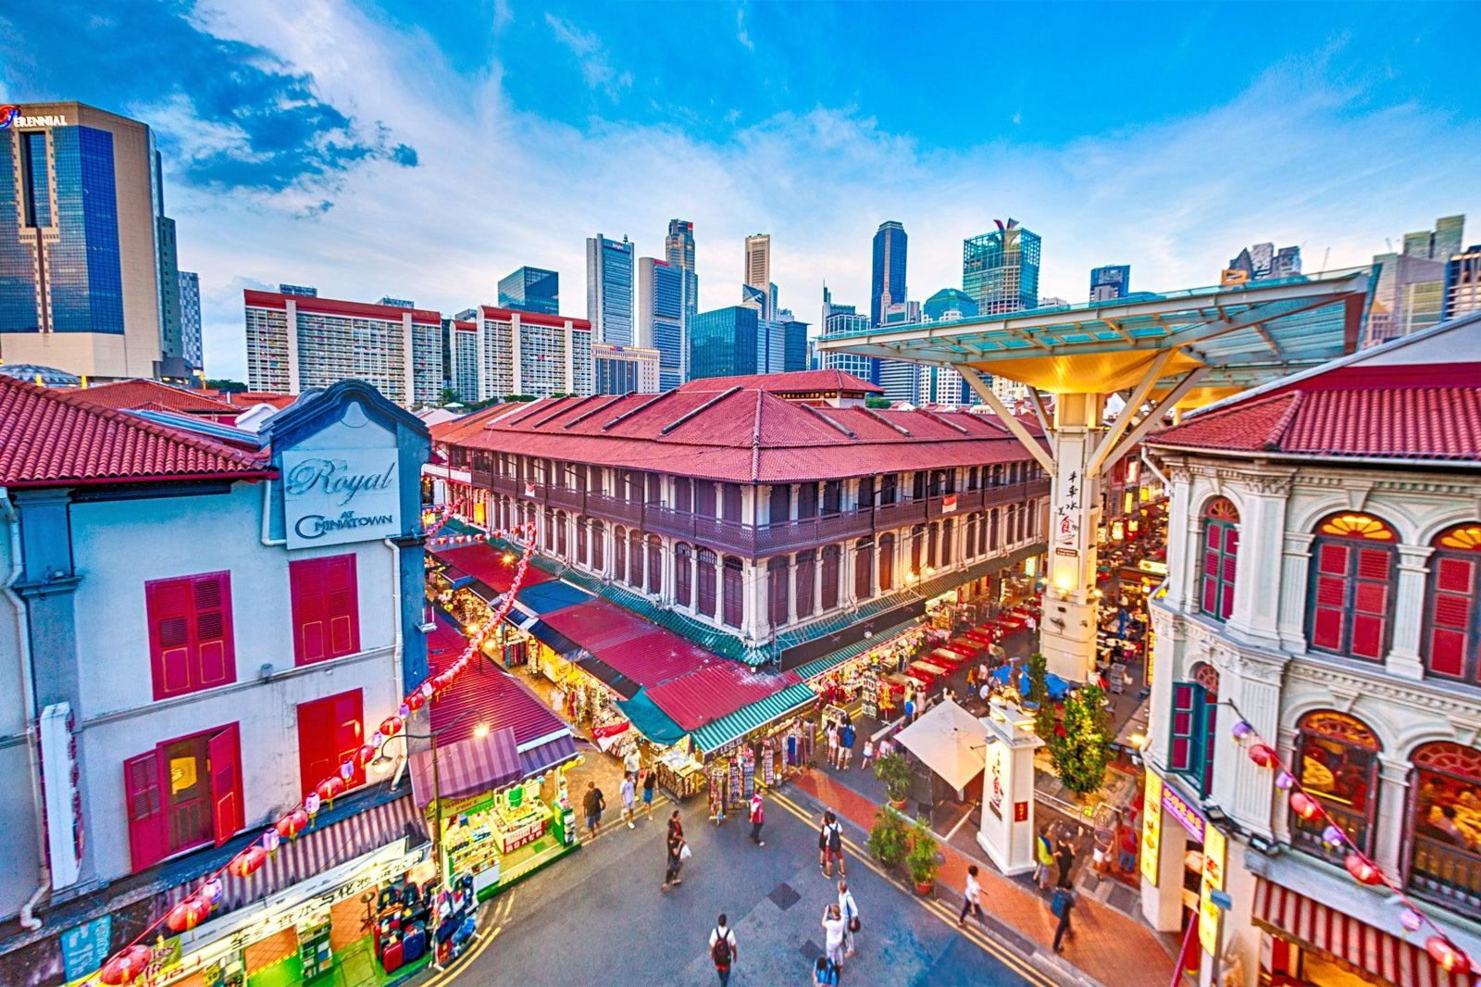
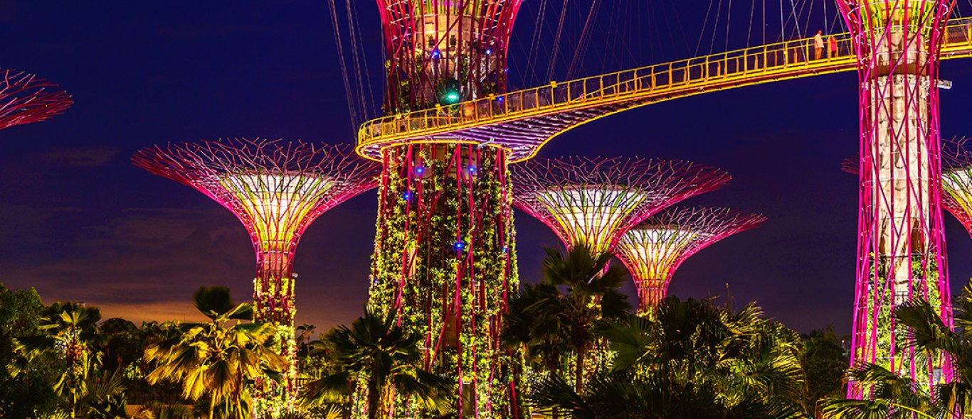
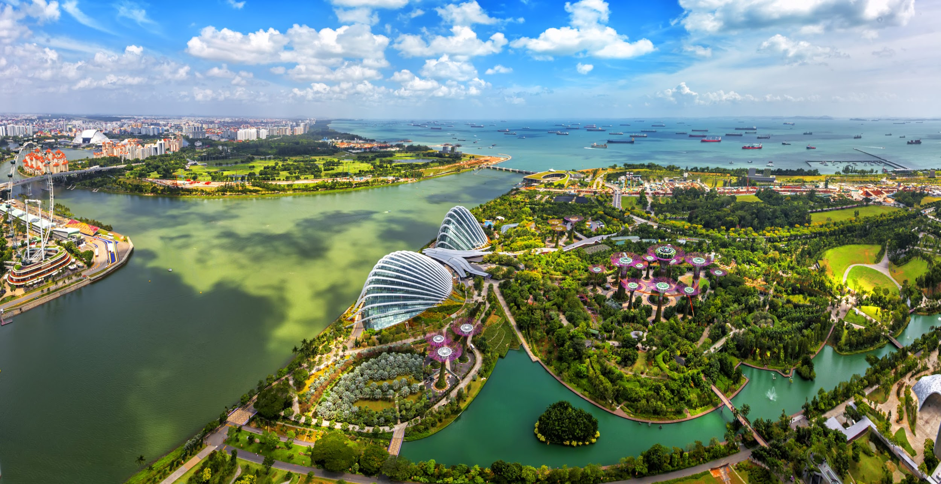
Leuke plaatjes

Slide 12

The details
When? Friday April 14th until Sunday April 23rd
Beware that when participating, you miss the retake week of the 2nd period.
How much? 800 euros max, but hopefully 750 euros
  Included: transportation, accommodation, 3 meals a day, visits to chemical companies and universities and a cultural activity!

Slide 13
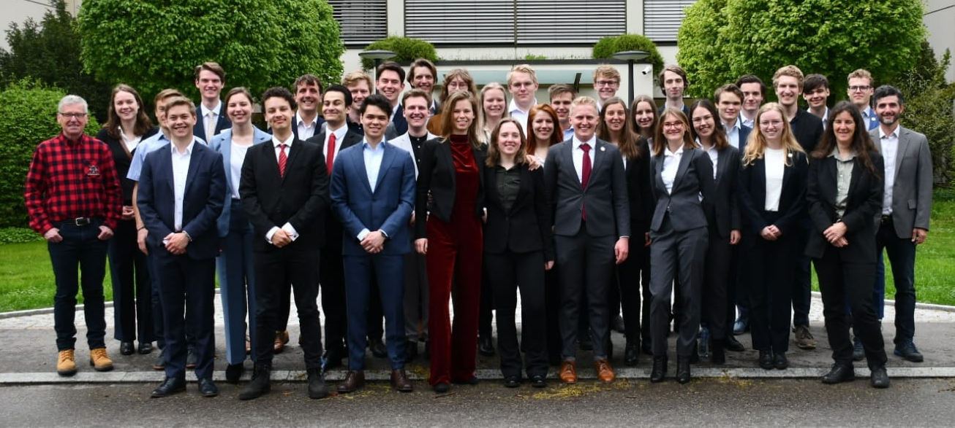
What do we expect?
24 enthusiastic participants (third-year Bachelor’s or older)
At least 2 Covid vaccines
Interested in chemistry and culture of the country visited
Active participation before, during and after the trip!
Neat clothing during visits

Slide 14
About the rules
Singapore is a very safe country, but they have very strict laws
DO NOT BRING OR USE ANY DRUGS 🡪 death sentence
Also not in the week before arrival
Don’t bring/use e-sigarettes or chewing gum
Smoking is forbidden almost everywhere
Public drinking is prohibited after 10.30 pm

Slide 15
Sign up now!
Deadline is December 6th
Poster to sign up will be in the Protonkamer after today
Selection procedure: drawing of lots
If it’s your first time, you will get two lots. If it’s your second time, you’ll get one.
Let us know which courses you will follow in the 3rd period so we can make sure participants do not have an exam on April 14th afternoon

Slide 16


Questions?
Ask them now (or later via e-mail/personally)
E-mail: info@protoninternational.nl
Website: www.protoninternational.nl
Instagram: @protonstagram_international

